Slide 1
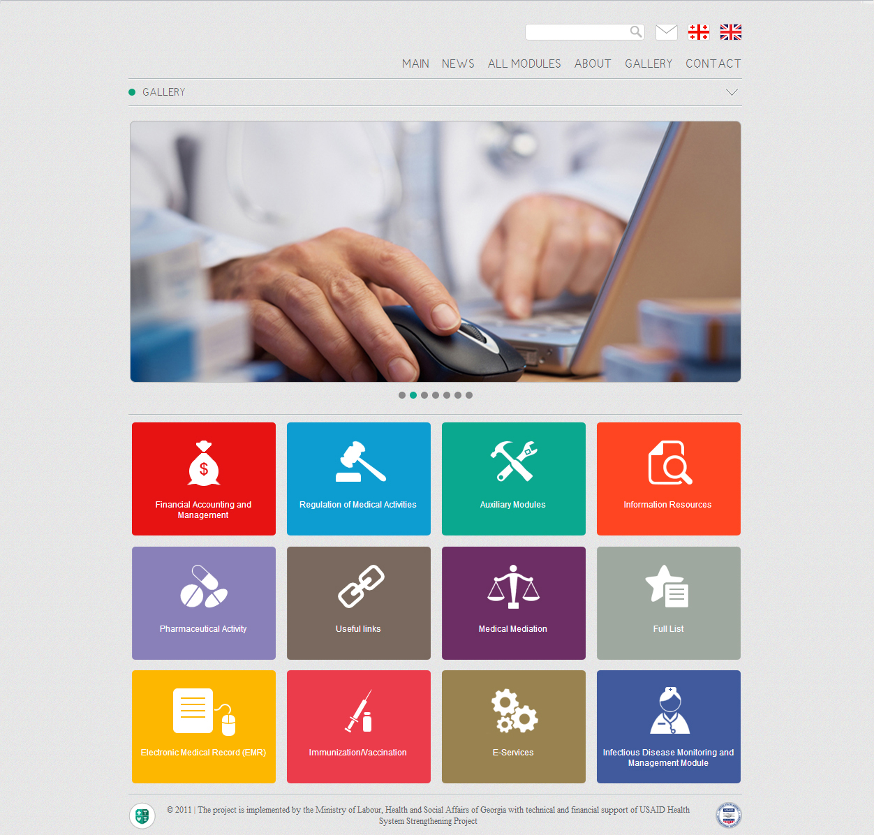


Health Management Information System (HMIS) Georgia
http://ehealth.moh.gov.ge/Hmis
USAID Health System Strengthening Project (HSSP)
October
2012

Slide 2
Goal of Health Management Information System
Health Management Information System – Main Characteristics
Information privacy and security
Common standard for data registration to ensure international comparability
Operational effectiveness and optimization of administration resources
Real-time monitoring of financial/healthcare data
Reliable statistics and analysis
Effective management of knowledge and experience; evidence–based clinical decision making
Policy and management decision making based on reliable data
Improved standardization and transparency of processes including service quality
Improved efficiency and control of healthcare programs

Slide 3

Pharmaceutical Activity Components
National Drug Code System (NDC)
Pharmacy Module
Pharmaceutical Products Module
E-Prescribing Module
E-Services
Pharmacy and Healthcare Network Information Portal
Electronic Drug Registration in eCTD (Common Technical Document) Module

Slide 4

Functional Architecture of Pharmaceutical Activity Components

Slide 5
National Drug Code System (NDC)
Weaknesses Revealed by Situational Analysis
Benefits of the System
Invalid methodology of government supervision
Problems with timely and qualified identification of products
Mechanically and differently interpreted data
Limited opportunities for marketing research
Finding items at any stage of product flow (import/export, transportation, logistics, distribution, pharmacy supplies and sales)
Monitoring and control of drug flow. Namely: software support for withdrawal of drugs from the market
Reduce inventory, labor and administrative expenses
Basic support for marketing researches

Slide 6
National Drug Code (NDC)
NDC
Finding and withdrawal of product from the market
Monitoring product distribution
Common standard for exchange of information between parties
009067
-
75280644
Registration
Number
Serial
Number
The National Drug Code (NDC) is a unique product identifier and consists of 2 segments. Segments are filled out automatically at different stages
Segment 1 is generated while registering the product and includes its “Registration Number” and also other important information, such as manufacturer/importer, pharmacological characteristics of product, period for permission on the marketplace, visual image, etc.
Segment 2 is assigned by the customs department during the import process and is automatically entered into the Pharmaceutical Products Module. In case of local production a manufacturer enters serial numbers of every batch into special electronic forms

Slide 7
Pharmacy Module
Weaknesses Revealed by Situational Analysis
Benefits of the Module
Inflexible platform for registration and control of information on pharmacies
Exchange of big volume of paper-based information and bureaucratic impediments
Duplicated and non-centralized data and reports, difficulties of monitoring and analysis
Centralized registration, identification (according to activity types) and management of all registered and functioning countrywide
Standardization of business processes and relevant information flows and fast and flexible analysis as a result of it
Automation and monitoring of inspection of pharmacies and pharmaceuticals

Slide 8
Pharmaceutical Products Module
Weaknesses Revealed by Situational Analysis
Benefits of the Module
Lack of common drug database and resources needed for its development
Problem with searching and finding big volume of paper-based information on pharmaceutical products
Flaws caused by methodological and technical problems related to process management and automation
Unstandardized form of existing databases and data and complicated analysis as a result of it
A complete list of pharmaceuticals permitted in Georgia
Opportunity for real-time exchange of information on import/export with the Customs according to the NDC
Ensure finding of pharmaceuticals by unique drug code – so called NDC
Ensure access to pharmacological and scientific information (drug annotations, clinical studies, etc.)
Provision of transparent information on manufacturers, packers and trading license holders in future

Slide 9
E-Prescribing Module
Benefits of the Module
Ensure cost-effective care and also opportunity to make informed decisions through automatic access to different medical and pharmacological resources
Control of the limit for drugs covered under government-funded and private health insurance plans
Eradication of fraud and duplication of care
Renewal of prescription for patients with chronic diseases without visiting doctors
Optimization of timely, human and financial resources based on electronic reporting
Centrally mobilized data; opportunity to gather reliable statistics and make an analysis

Slide 10
E-Services Component
Benefits of the Component
Simplified information exchange between the Ministry of Labour, Health and other stakeholders
Opportunity to get electronic permits , licenses and other formal documents
Opportunity to receive electronic notifications
Standard and accelerated regimes for submission and acceptance of formal documents
Monitoring of transparent process; saved timely and administrative resources

Slide 11
Pharmacy and Healthcare Network Information Portal
Benefits of the Portal
Access to geographic and price-based information on pharmaceutical and medical services
Flexible tool to select clinics and pharmacies
Price transparency and dynamics
Opportunity to receive information on geographic and organizational distribution of medical staff
The largest source of information to evaluate different capacities/resources countrywide

Slide 12
Electronic Drug Registration in eCTD (Common Technical Document) Module
Benefits of the Module
 | MoLHSA | Pharmacies | Importer/ Stakeholder
Standardization of normative and technical dossier along with expertise processes | ☑
Compliance of the registration process with international standards and technical possibility to connect reliable regulators to analogous registration interface | ☑ | ☑ | ☑
Registration of high-quality drugs | ☑ | ☑ | ☑
Optimization of timely, financial and technical resources | ☑ | ☑ | ☑
Data systematization and simplified data search | ☑ | ☑ | ☑

Slide 13
Other Important Health Management Information System Components
Immunization/ Vaccination
Medical Mediation
Analytic Tools
Financial Accounting and Management
Regulation of Medical Activities
Medical Classifications
User Management Module

Slide 14
New Modules are coming with New Ideas…

Slide 15
Health Management Information System Website
http://ehealth.moh.gov.ge/Hmis/Portal/Default.aspx
User Manuals and Video Tutorials in English language can be found in Help menu of each module.
Thank you for attention!

